Slide 1

Student Feedback

Slide 2
LEQs and SEQs (2022)

Slide 3
Overall Improvement: SEQ scores generally increased each year from 2020 to 2022, indicating rising student satisfaction.
2021 Peak: Practical aspects and library resources peaked in 2021.
2022 Gains: Workload manageability and critical thinking showed significant improvement in 2022.
Lowest in 2020: 2020 had the lowest scores across most categories, highlighting progress in subsequent years.

Slide 4
Gradual Improvement: SEQRTL scores showed slight improvements from 2020 to 2022, with overall satisfaction rising.
2021 Peak: Data adequacy, communication, and access to learning materials peaked in 2021.
Device Availability: Availability of smartphones, laptops, and tablets, along with workspace, improved gradually over the years.
Stability: Understanding of course content remained stable, indicating consistent support in remote teaching and learning.

Slide 5
Overall Improvement: LEQ scores improved from 2020 to 2022, reflecting a better learning environment.
Significant Gains: Communication clarity, student engagement, and feedback provision saw notable increases in 2021 and 2022.
Stability: Areas like preparation and the use of visual aids remained stable over the three years.
Positive Trend: The data indicates a steady enhancement in teaching methods and student interaction.

Slide 6
Steady Improvement: LEQRTL scores increased consistently from 2020 to 2022, reflecting enhanced remote teaching and learning quality.
Highest Ratings in 2022: Questioning styles, assessment guidelines, and feedback were rated highest in 2022.
Engagement Growth: Student engagement and relevance to work showed noticeable improvements over the years.
Positive Trend: The overall data suggests continuous improvement in the quality of remote education.

Slide 7
Graduate Survey

Slide 8
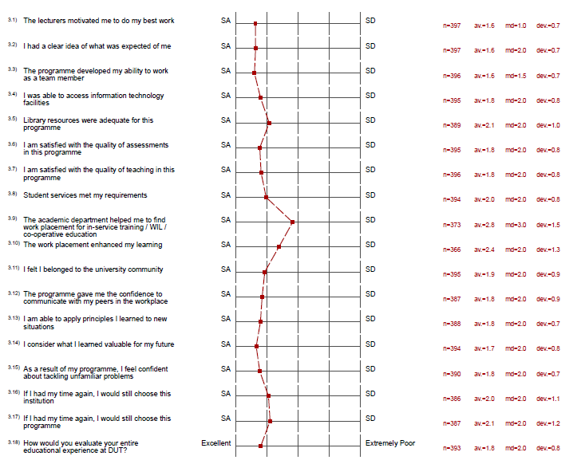
The chart presents student evaluations of their educational experience at DUT, rated from Strongly Agree (SA) to Strongly Disagree (SD). Students highly agreed on the clarity of expectations, development of team-working skills, and assessment quality. There is moderate agreement on access to IT facilities, teaching quality, and student services. Lower agreement levels were observed for the sense of community, work placement support, and confidence in tackling unfamiliar problems. Overall, the educational experience at DUT is rated positively, with most aspects leaning towards agreement.

Slide 9
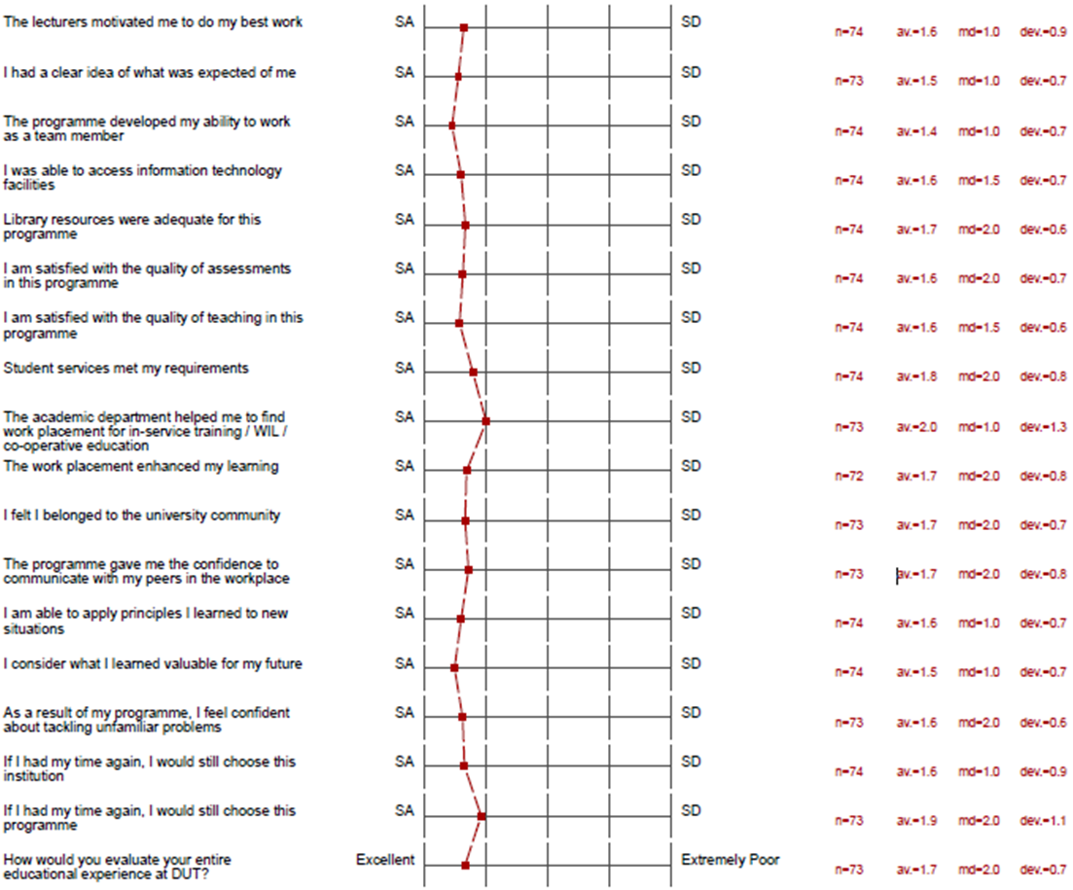
Applied Sciences Spring Graduation. 75 responses were recorded
The chart shows DUT student evaluations, rated from Strongly Agree (SA) to Strongly Disagree (SD). High agreement was for clarity of expectations, team-working skills, and assessment quality (around 1.5). Moderate agreement for IT access, teaching quality, and student services (1.6-1.8). Lower agreement for sense of community, work placement support, and tackling problems (near 2.0). Overall, students rated their experience positively, especially for clarity, assessments, and teamwork.

Slide 10
Full-Time Employment Increase: Rose significantly from 13.2% in June 2020 to 33.3% by September 2022.
Part-Time Employment Fluctuations: Peaked at 26.9% in November 2020, then declined to 19.4% by September 2022.
Low Self-Employment: Remained consistently low, peaking at just 8.0% during the period.
Non-Working Rates Decline: Decreased from 75.2% in June 2020 to 45.8% by September 2022, reflecting a positive trend in employment.
The graph shows employment trends from June 2020 to September 2022. Full-time employment rose from 13.2% to 33.3%, while part-time employment peaked at 26.9% in November 2020 and ended at 19.4%. Self-employment remained low, peaking at 8.0%. Those not working decreased from 75.2% to 45.8%. Overall, full-time employment increased significantly, and non-working rates dropped.

Slide 11
Surge in Full-Time Employment: Rose from 13.2% in June 2020 to 33.3% in September 2022.
Part-Time Employment Decline: Peaked at 26.9% in November 2020, then fell to 19.4% by September 2022.
Consistent Low Self-Employment: Remained low, with a peak of only 8.0%.

Slide 12

5. Curriculum Renewal

Slide 13
Curriculum Renewal Project
43 new qualifications sent to CHE
New Qualifications
2012 (8) | 2014 (2) | 2015 (5) | 2016 (6) | 2017 (3) | 2018 (9) | 2019 (4) | 2020 (2) | 2021 (4)
Master of Applied Science in Biotechnology | Diploma in Shipping and Logistics | Diploma in Textile Technology | Higher Certificate in Sport Management Science | Diploma in Clothing Management | Postgraduate Diploma in International Shipping | Postgraduate Diploma in Food and Nutrition | Higher Certificate in Applied Sciences | Bachelor of Applied Science in Industrial Chemistry
Master of Applied Science in Food Science | Diploma in Nautical Studies | Diploma in Sustainable Horticulture and Landscaping | Diploma in Consumer Science Food and Nutrition | Bachelor of Applied Science in Sport Science & Management | Advanced Diploma in Apparel Technology | Postgraduate Diploma in Sustainable Horticulture | Postgraduate Diploma in Chemistry | Bachelor of Sport Science Honours
Master of Applied Science in Chemistry |  | Diploma in Analytical Chemistry | Bachelor of Applied Science in Food Science and Technology | Bachelor of Applied Science in Textile Science | Advanced Diploma in Textile Technology | Advanced Diploma in Biotechnology |  | Bachelor of Applied Science Honours in Textile Science
Master of Applied Science in Food & Nutrition |  | Bachelor of Applied Science in Biotechnology | Advanced Diploma in Shipping and Logistics |  | Advanced Diploma in Sustainable Horticulture | Advanced Diploma in Food Science |  | Master of Maritime Studies
PhD in Biotechnology |  | PhD in Applied Science | Advanced Diploma in Nautical Studies |  | Advanced Diploma in Consumer Sciences in Food & Nutrition
PhD in Food Science |  |  | Advanced Diploma in Marine Engineering |  | Advanced Diploma in Chemistry
PhD in Chemistry |  |  |  |  | Bachelor of Applied Science Honours in Food Science
PhD in Food & Nutrition |  |  |  |  | Bachelor of Applied Science Honours in Biotechnology
 |  |  |  |  | Higher Certificate in Sport Coaching Science
8 | 10 | 15 | 21 | 24 | 33 | 37 | 39 | 43
39 currently being offered @ DUT
3 x Higher Certificate’s
7 x Diploma’s
10 x Advanced Diploma’s
5 x Bachelor’s Degree’s
4 x Bachelor Honours ‘s Degree
4 x Postgraduate Diploma
5 x PhD
5 x Masters

Slide 14

6. Financial Viability

Slide 20
20

Slide 23
2021 Net Surplus/Deficit

Slide 25
No. | Department | Current Projects
 | Biotechnology and Food Technology | 5
2. | Chemistry | 6
3. | Clothing and Textiles | 2
4. | Food and Nutrition | 4
5. | Horticulture | 8
6. | Maritime Studies | 9
7. | Sports Studies | 10
8. | Maths | 1
9. | Physics | 6
10. | Statistics | 2
 |  | 53
25

Slide 26
7. Research

Slide 27
Full Professors (10) | Associate Professors (10)
Prof Suren Singh | Prof Darren Lortan
Prof Deonarain Brijlal | Prof David Day
Prof Nirmala Deenadayalu | Prof Feroz Swalaha
Prof Megandhren Govender | Prof Ian Lazarus
Prof Kugen Permaul | Prof Sanja Bauk
Prof Robert Gengan | Prof Cindy Pienaar
Prof Krishna Bisetty | Prof John Mellem
Prof Tukayi Kudanga | Prof Viresh Mohanlall
Prof Eric Amonsou | Prof Sheena KK Pillai
Prof Oluwatosin Ijabadeniyi | Prof Santhosh KK Pillai
Faculty Professors

Slide 28
Rating | NRF Rated Scientists
B3 | Prof Suren Singh
C1 | Prof Krishna Bisetty
C2 | Prof Megandhren Govender
C2 | Prof Kugen Permaul
C2 | Prof Tukayi Kudanga
C2 | Prof Oluwatosin Ijabadeniyi
C2 | Prof Nirmala Deenadayalu
C2 | Prof Eric Amonsou
C2 | Prof Robert Gengan
C2 | Prof Deonarain Brijlall
C2 | Prof John Mellem
C2 | Prof Feroz Swalaha
C2 | Prof Santhosh KK Pillai
C2 | Dr Mack Moyo
Y2 | Dr Sabiu Saheed
Y2 | Dr Myalowenkosi Sabela
NRF Rated Scientists

Slide 29
RESEARCH FOCUS AREAS
RESEARCH FOCUS AREAS | RESEARCH AREAS
1. ENZYME TECHNOLOGY Prof S. Singh/ Prof K Permaul/ Prof T Kudanga /Prof Santhosh KK Pillai (Biotechnology & Food Science) | 1. BIOMASS PROCESSING Prof N Deenadayalu (Chemistry)
2. Food and nutrition security Prof EO Amonsou and Prof C Napier (Food Science and Food and Nutrition) | 2. ORGANO-NANO SYNTHESIS Prof RM Gengan (Chemistry)
3. PLANT BIOTECHNOLOGY Dr V Mohanlall (Biotechnology & Food Science) | 3. PHASE EQUILIBRIA AND ELECTROANALYTICAL CHEMISTRY Prof GG Redhi (Chemistry)
4. COMPUTATIONAL MODELLING AND BIOANALYTICAL CHEMISTRY Prof K Bisetty (Chemistry) | 4. ENVIRONMENTAL CHEMISTRY Prof PS Mdluli (Chemistry)
5. SUSTAINABLE ENERGY Prof I Lazarus (Physics)

Slide 30
2014: 33.45
2015: 35.26
2016: 54.23
2017: 113.54
2018: 102.5
2019: 105.31
2020: 132.59
2021: 109.18
2022: 149.80
RESEARCH OUTPUTS

Slide 32
Department | No. of Publications | No. of Masters Graduates | No. of PhD Graduates | Total Dept. Units | Avg. Units per Staff
BIOTECHNOLOGY | 18 (8.54 units) | 5 (5 units) | 1 (3 units) | 16.54 | 2.36 (7 staff)
FOOD SCIENCE AND TECH | 18 (14.1 units) | 4 (4 units) | 2 (6 units) | 24.1 | 6.025 (4 staff)
CHEMISTRY | 36 (23.34 units) | 9 (9 units) | 2 (6 units) | 38.34 | 3.83 (10 staff)
FOOD AND NUTRITION | 0 | 4 (4 units) | 1 (3 units) | 7 | 1 (7 staff)
MATHEMATICS | 32 (22.03 units) | - | - | 22.03 | 2 (11 staff)
STATISTICS | 0 | - | - | - | 0 (5 staff)
PHYSICS | 8 (1.46 units) | - | - | 1.46 | 0.21 (7 staff)
HORTICULTURE | 1 (1 unit) | - | - | 1 | 0.2 (5 staff)
SPORTS STUDIES | 1 (0.25 units) | - | - | 0.25 | 0.05 (5 staff)
MARITIME STUDIES | 7 (2.82 units) | - | - | 2.82 | 0.56 (5 staff)
CLOTHING AND TEXTILE | 0 | - | - | - | (5 staff)
FACULTY | 121 (73.54 units) | 22 (22 units) | 6 (18 units) | 113.54 | 1.6 (71 staff)
2017 Research Data

Slide 33
Department | Number of Publications | No of Masters graduates | No of PhD graduates | Units Dept. | Units Staff
BIOTECHNOLOGY | 28 (11.61 units) | 7 (7 units) | 3 (9 units) | 27.61 | 3.45 (8 staff)
FOOD TECHNOLOGY | 10 (7.53 units) | 3 (3 units) | 2 (6 units) | 16.53 | 4.13 (4 staff)
CHEMISTRY | 37 (29.42 units) | 4 (4 units) | 5 (15 units) | 48.42 | 3.72 (13 staff)
FOOD AND NUTRITION | 2 (0.83 units) | 2 (2 units) | - | 2.83 | 0.40 (7 staff)
MATHEMATICS | 4 (3 units) |  |  | 3 | 0.25 (12 staff)
STATISTICS | 1 (0.17 units) |  |  | 0.17 | 0.034 (5 staff)
PHYSICS | 3 (1.08 units) |  |  | 1.08 | 0.15 (7 staff)
HORTICULTURE | 2 (0.53 units) |  |  | 0.53 | 0.11 (5 staff)
SPORTS STUDIES | - |  |  | - | (4 staff)
MARITIME STUDIES | 5 (2.33 units) |  |  | 2.33 | 0.47 (5 staff)
CLOTHING AND TEXTILE | - |  |  |  | (6 staff)
FACULTY | 92 (56.5 units) | 16 (16 units) | 10 (30 units) | 102.5 | 1.35 (76 staff)
2018 Research Data

Slide 34
2020 Research Data
Department | Units Dept. | Units Staff
BIOTECHNOLOGY | 46.76 | 5.85 (8 staff)
FOOD SCIENCE | 19.3 | 3.86 (5 staff)
CHEMISTRY | 45.13 | 4.10 (11 staff)
FOOD AND NUTRITION | 7.65 | 0.85 (9 staff)
MATHEMATICS | 9.94 | 0.71 (14 staff)
STATISTICS | 1 | 0.17 (6 staff)
PHYSICS | 0.66 | 0.07 (9 staff)
HORTICULTURE | 0.5 | 0.06 (8 staff)
SPORTS STUDIES | 0.2 | 0.03 (6 staff)
MARITIME STUDIES | 1.60 | 0.23 (7 staff)
CLOTHING AND TEXTILE | - | 0 (6 staff)
FACULTY | 132.74 | 1.49 (89 staff)

Slide 35
Department | Number of Publications | No of Masters graduates | No of PhD graduates | Units Dept. | Units Staff
BIOTECHNOLOGY | 58 (14.6483 units) | 2 (2 units) | 4 (12 units) | 28.6483 | 3.45 (8 staff)
FOOD TECHNOLOGY | 12 (8.3429 units) | 1 (1 units) | 1 (3 units) | 12.3429 | 4.13 (4 staff)
CHEMISTRY | 52 (29.4329 units) | 8 (8 units) | 2 (6 units) | 43.4329 | 3.72 (13 staff)
FOOD AND NUTRITION | 2 (1.33 units) | 3 (3 units) | - | 4.33 | 0.40 (7 staff)
MATHEMATICS | 16 (8.0866 units) |  |  | 8.0866 | 0.25 (12 staff)
STATISTICS | - |  |  | - | 0.034 (5 staff)
PHYSICS | 6 (0.88 units) |  |  | 0.88 | 0.15 (7 staff)
HORTICULTURE | 1 (0.33 units) |  |  | 0.33 | 0.11 (5 staff)
SPORTS STUDIES | 8 (2.29) |  |  | 2.29 | (4 staff)
MARITIME STUDIES | 10 (4.97 units) |  |  | 4.97 | 0.47 (5 staff)
CLOTHING AND TEXTILE | - |  |  | - | (6 staff)
FACULTY | 165 (70.3107 units) | 14 (14 units) | 7 (21 units) | 105.3107 | 1.30 (81 staff)
2019 Research Data

Slide 36
2021 Research Data
Department | Number of Publications | No of Masters graduates | No of PhD graduates | Units Dept. | Units Staff
BIOTECHNOLOGY | 134 (24.98 units) | 1 (1 unit) | 3 (9 units) | 34.98 | 4.37 (8 staff)
FOOD SCIENCE | 36 (8.68 units) | 2 (2 units) |  | 10.68 | 2.14 (5 staff)
CHEMISTRY | 70 (19.85 units) | 6 (6 units) | 2 (6 units) | 31.85 | 2.90 (11 staff)
FOOD AND NUTRITION | 9 (2.44 units) | 3 (3 units) |  | 5.44 | 0.60 (9 staff)
MATHEMATICS | 13 (4.16 units) |  |  | 4.16 | 0.30 (14 staff)
STATISTICS | - | - | - | - | 0 (4 staff)
PHYSICS | 3 (0.83 units) | - | 1 (3 units) | 3.83 | 0.43 (9 staff)
HORTICULTURE | 3 (1.33 units) |  |  | 1.33 | 0.19 (7 staff)
SPORTS STUDIES | - | - | - | - | 0 (5 staff)
MARITIME STUDIES | 6 (16.66 units) |  |  | 16.66 | 2.78 (6 staff)
CLOTHING AND TEXTILE | 1 (0.25) |  |  | 0.25 | 0.04 (6 staff)
FACULTY | 275 (79.18 units) | 12 (12 units) | 6 (18 units) | 109.18 | 1.30 (84 staff)

Slide 37
2022 Research Data
Department | Number of Publications | No of Masters graduates | No of PhD graduates | Units Dept. | Units Staff
BIOTECHNOLOGY | 108 (43.86 units) | 8 (8 unit) | 4 (12 units) | 63.86 | 7.98 (8 staff)
FOOD SCIENCE | 34 (8.77 units) | - | - | 8.77 | 1.75 (5 staff)
CHEMISTRY | 74 (29.37 units) | 7 (7 units) | 2 (6 units) | 42.37 | 3.26 (13 staff)
FOOD AND NUTRITION | 6 (3.09 units) | 3 (3 units) | 1 (3 units) | 9.09 | 1.14 (8 staff)
MATHEMATICS | 20 (8.38 units) | - | - | 8.38 | 0.56 (15 staff)
STATISTICS | 2 (0.66 units) | - | - | 0.66 | 0.13 (5 staff)
PHYSICS | 5 (1.37 units) | - | - | 1.37 | 0.15 (9 staff)
HORTICULTURE | 3 (1.17 units) | - | - | 1.17 | 0.15 (8 staff)
SPORTS STUDIES | 1 (0.13 units) | - | - | 0.13 | 0.02 (6 staff)
MARITIME STUDIES | 9 (14 units) | - | - | 14 | 2.33 (6 staff)
CLOTHING AND TEXTILE | - | - | - | - | 0 (6 staff)
FACULTY | 262 (110.80 units) | 18 (18 units) | 7 (21 units) | 149.80 | 1.68 (89 staff)

Slide 38
DEPARTMENT | NRF | THUTHUKA | BILATERAL | GLOBAL GRANTS | RDG/ UCDG | INTERNATIONAL MOBILITY | OTHER | TOTAL
BIOTECH/FOOD TECH | R876 000 | R1 718 000 | R1 141 000 |  | R390 000 | R50 000 | R506 000 | R4 681 000
CHEMISTRY | R1 917 000 | R1 168 000 |  |  | R240 000 |  |  | R3 325 000
FOOD AND NUTRITION |  |  |  | R746 640 |  |  |  | R746 640
MATHEMATICS
STATISTICS
PHYSICS | R30 000 |  |  |  |  |  |  | R30 000
HORTICULTURE | R180 000 | R206 066 |  |  |  |  |  | R386 066
SPORTS STUDIES
MARITIME STUDIES |  |  | R16 680 |  |  | R258 540 |  | R275 220
CLOTHING AND TEXTILE
TOTAL | R3 003 000 | R3 092 066 | R1 157 680 | R746 640 | R630 000 | R308 540 | R506 000 | R9 443 926
Research Grants 2017/2018

Slide 39
Research Grants 2018
DEPARTMENT | NRF | THUTHUKA | BILATERAL | GLOBAL GRANTS | RDG/ UCDG | INTERNATIONAL MOBILITY | OTHER | TOTAL
BIOTECHNOLOGY | R739 540 | R415 000 | R2 146 000 | R2 100 000 | R240 000 | R25 000 |  | R5 665 540
FOOD TECHNOLOGY | R165 000 |  | R848 600 |  | R80 000 |  |  | R1 093 600
CHEMISTRY | R1 434 000 | R442 000 |  |  |  |  |  | R1 876 000
FOOD AND NUTRITION |  |  |  | R746 640 |  |  |  | R746 640
MATHEMATICS
STATISTICS
PHYSICS | R30 000 |  |  |  |  |  |  | R30 000
HORTICULTURE | R90 000 | R150 426 |  |  |  |  |  | R240 426
SPORTS STUDIES
MARITIME STUDIES | R48 748 |  |  | R968 426 |  |  |  | R1 017 174
CLOTHING AND TEXTILE
TOTAL | R2 507 288 | R1 007 426 | R2 994 600 | R3 815 066 | R320 000 | R25 000 |  | R10 669 380

Slide 40
Research Grants 2019
DEPARTMENT | NRF | THUTHUKA | BILATERAL | GLOBAL GRANTS | RDG/ UCDG | INTERNATIONAL MOBILITY | OTHER | TOTAL
BIOTECHNOLOGY | R288 139 | R372 000 | R850 000 | R690 000 | R730 000 | R20 000 |  | R2 950 139
FOOD TECHNOLOGY | R411 666 | R282 000 |  |  |  | R97 000 |  | R790 666
CHEMISTRY | R350 000 | R350 000 | R3 000 000 | R70 000 |  |  |  | R3 770 000
FOOD AND NUTRITION
MATHEMATICS
STATISTICS
PHYSICS
HORTICULTURE |  |  |  |  |  |  | R140 000 | R140 000
SPORTS STUDIES
MARITIME STUDIES
CLOTHING AND TEXTILE
TOTAL | R1 049 805 | R1 004 000 | R3 850 000 | R760 000 | R730 000 | R117 000 | R140 000 | R7 650 805

Slide 41
Research Grants 2020
DEPARTMENT | NRF | UCDG | RESEARCH OUTPUTS | OTHER | TOTAL
BIOTECHNOLOGY | R 794 312,23 | R 690 000 | R 344 844,46 | R 1 245 089,16 | R 3 074 245,85
FOOD SCIENCE | R 263 126,20 | R 200 000 | R 281 608,72 |  | R 744 734,92
CHEMISTRY | R 655 544,35 | R 320 000 | R 500 252,41 | R 250 000,00 | R 1 725 796,76
FOOD AND NUTRITION |  |  | R 13 029,40 | R 1 455 351,48 | R 1 468 380,88
MATHEMATICS |  |  | R 203 258,60 |  | R 203 258,60
STATISTICS |  |  |  |  | -
PHYSICS |  |  |  |  | R 960 067,78
HORTICULTURE | R 4 818,70 |  |  |  | R 4 818,70
SPORTS STUDIES |  |  |  |  | -
MARITIME STUDIES |  |  | R 104 236,00 |  | R 104 236,00
TEXTILE SCIENCE & APPAREL TECH |  |  |  |  | -
TOTAL | R 1 717 801,48 | R 1 210 000 | R 1 447 229,59 | R 3 910 508,42 | R8 285 539,49
Biotechnology and Food Sciences Combined: R3 818 980,77

Slide 42
Research Grants 2021
DEPARTMENT | NRF | UCDG | RESEARCH OUTPUTS | OTHER | TOTAL
BIOTECHNOLOGY | 2 830 350,23 | 495 000,00 | 308 098,42 |  | 3 633 448,65
FOOD SCIENCE | 1 153 545,19 | 420 000,00 | 305 131,18 | 395 000,00 | 2 273 676,37
CHEMISTRY | 1 233 050,52 | 502 500,00 | 674 058,02 | 50 000,00 | 2 459 608,54
FOOD AND NUTRITION |  |  | 16 319,82 | 301 875,00 | 318 194,82
MATHEMATICS | 90 000,00 |  | 352 359,76 | 74 189,79 | 516 549,55
STATISTICS
PHYSICS |  |  | 49 948,58 |  | 49 948,58
HORTICULTURE | 50 000,00 | 40 000,00 |  |  | 90 000
SPORTS STUDIES
MARITIME STUDIES |  | 180 000,00 | 1 090 955,24 |  | 1 270 955,24
TEXTILE SCIENCE & APPAREL TECH
TOTAL | 5 356 945,94 | 1 637 500,00 | 2 796 871,02 | 821 064,79 | 10 612 381,75
Biotechnology and Food Science: R 5 907 125,02

Slide 43
Research Grants 2022
DEPARTMENT | EXTERNAL FUNDS | RESEARCH OUTPUTS | NRF FUNDING | RFA FUNDING | TOTAL
BIOTECHNOLOGY AND FOOD SCIENCE | R 158 824 | R 1 012 181.03 | R2 441 237.17 | R 1 120 000 | R 4 732 242.20
CHEMISTRY | R 97 750 | R 670 359.40 | R 1 327 860.85 | R 385 000 | R 2 480 970.25
FOOD AND NUTRITION | R 215 165.00 | R 123 693.18 | - | R 30 000 | R 368 858.18
PHYSICS | 0 | R 29 857.80 | 0 | 0 | R 29 857.80
MATHEMATICS | R 347 519.19 | R 311 357.09 | R 72 369.86 | 0 | R 731 246.14
STATISTICS | 0 | R 25 592.40 |  |  | R 25 592.40
HORTICULTURE | 0 | 0 | 0 | R 150 000 | R 150 000
MARITIME STUDIES | 0 | R 156 538.47 | 0 | R 150 000 | R 306 538.47
TOTAL | R 819 258.19 | R 2 329 579.37 | R 3 841 467.88 | R 1 835 000 | R 8 825 305.44
Biotechnology and Food Science: R 4 732 242.20

Slide 45
CONFERENCES 2017 - 2021

Slide 46
NUMBER OF GRADUATES 2017 - 2022

Slide 47
COLLABORATIONS 2017 - 2021

Slide 48
8. Additional slides

Slide 49
DEPARTMENT | BUDGET
Faculty | R553 626
Biotech & Food tech | R2 107 327
Chemistry | R2 270 000
Horticulture | R515 898
Clothing & Textile | R400 000
Food & nut | R839 400
Maritime Studies | R6 560 000
Sports Studies | R788 892
Maths, Stats & Physics | R998 200
Total | R15 033 343
FAS CAPEX SUMMARY REPORT - 2018

Slide 50
2018 CAPEX = R15 033 343
2020 CAPEX = R14 563 241
FAS Labs Funded = R8 000 000
FAS CAPEX SUMMARY REPORT - 2020

Slide 51
FAS CAPEX SUMMARY REPORT - 2022

Slide 52
No. | Department | Academic Programme | Full Name of the Module | Module Code
 | Statistics | Bachelor of the Built Environment in Urban and Regional Planning | Statistics for the Built Environment | STBE101
2. | Food and Nutrition | National Diploma: Consumer Science Food and Nutrition (ECP) | Consumer Science Practice I | CSCP101
 |  | National Diploma: Consumer Science Food and Nutrition | Consumer Behaviour 1 | CNSB101
3. | Biotechnology and Food Technology | Bachelor of Applied Science in Biotechnology | Biology I | BIOL101
 |  | Bachelor of Applied Science in Biotechnology | Biology I | BIOL101
 |  |  | Virology and Immunology 2 | VRIM201
4. | Clothing & Textiles | National Diploma: Textile Technology | Industrial Studies III | INDS301
 |  | National Diploma: Clothing Management | Production Technology III | PRDT301
5. | Maritime Studies | Advanced Diploma in Shipping and Logistics | Global Maritime Domain | GLMD101
 |  | Diploma in Shipping and Logistics | Port and Terminal Management | PTMN301
 |  | Advanced Diploma in Nautical Studies | Global Maritime Domain | GLMD101
 |  | Diploma in Nautical Studies | Shipboard Management | SHPM301
6. | Sport Studies | National Diploma: Sport Management | Sport Public Relations 1 | SPBR101
 |  |  | Sport Management 2 | SPMT201
 |  |  | Sport Management 3 | SPMT301
 |  | Higher Certificate in Sport Management Science | Sport Business Administration | SPBA101
 |  |  | Principles of Coaching | PCHN101
7. | Horticulture | National Diploma: Horticulture | Environmental Studies 2 | ESTD201
 |  | Diploma in Sustainable Horticulture and Landscaping | Environmental Sustainability 2A | EVSA201
 |  |  | Environmental Sustainability 2B | EVSB201
8. | Chemistry | Diploma in Analytical Chemistry | Applied Inorganic Chemistry | APIC101
9. | Physics | Bachelor of Health Sciences in Homeopathy | Physics I | PHHC111
DECOLONISATION
MODULES TO BE DECOLONISED IN THE FACULTY OF APPLIED SCIENCES

Slide 53
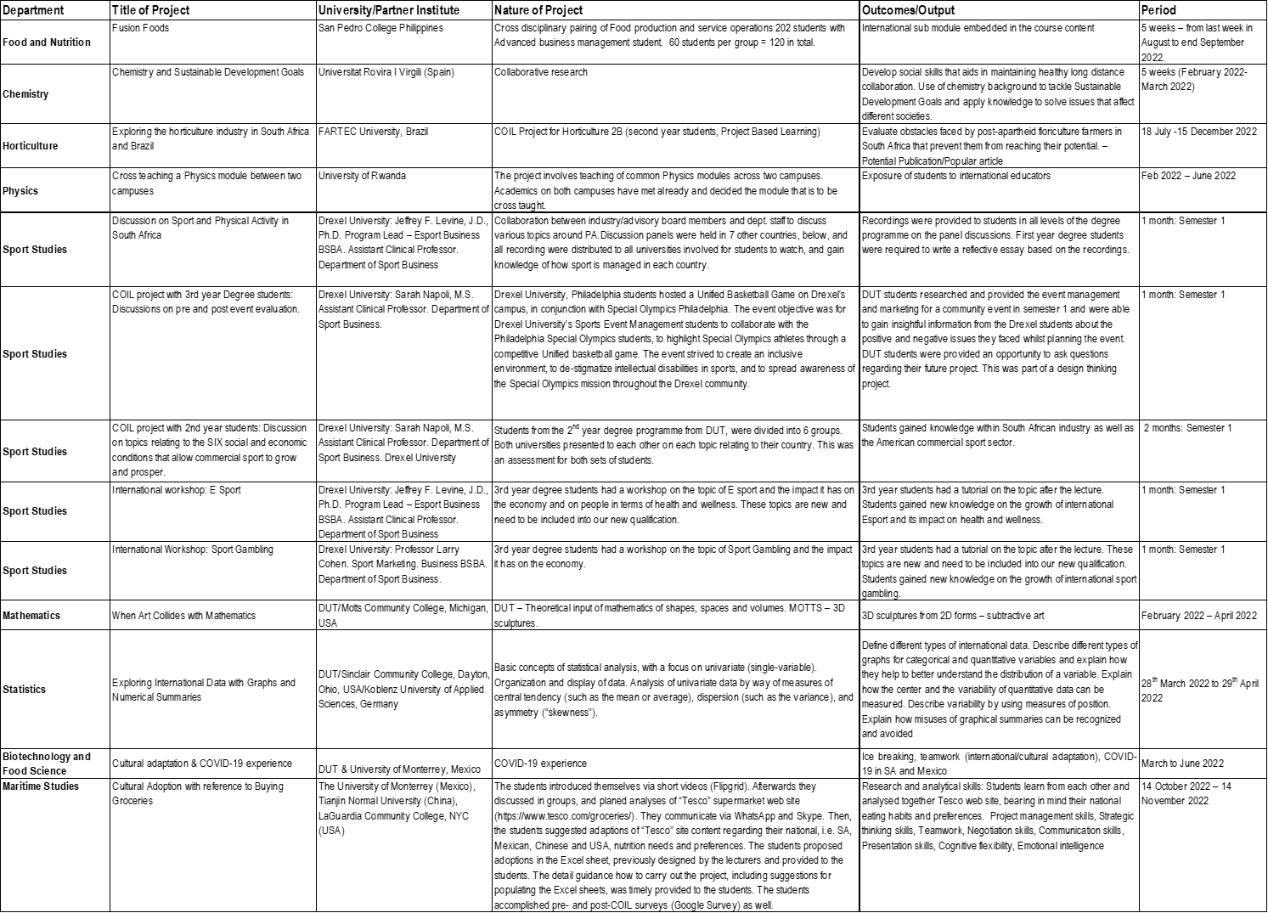
COIL PROJECTS

Slide 54




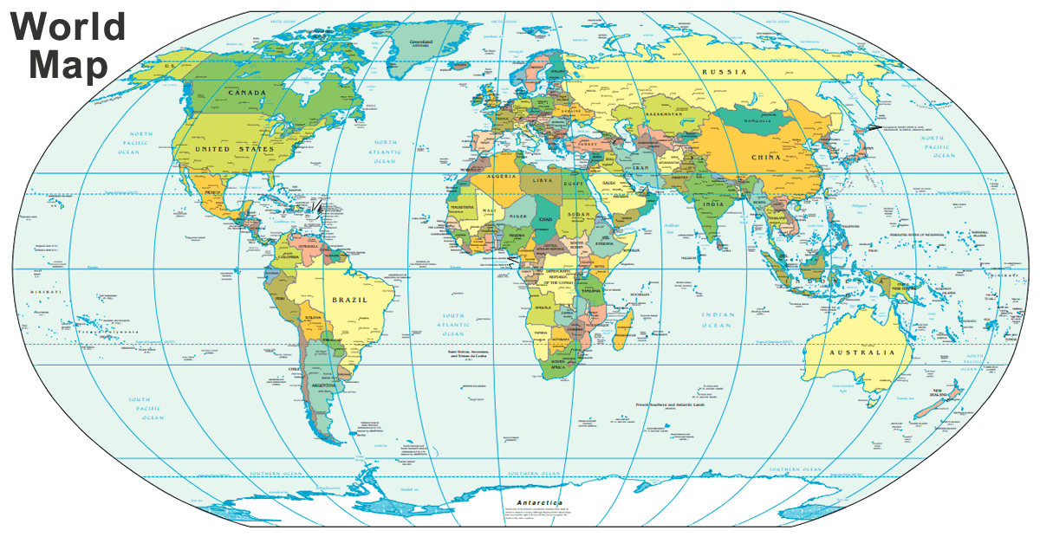





France: Biotechnology & Food Technology
Staff Exchange
Germany: Food & Nutrition
Austria: Biotechnology & Food Technology
China: Maritime, Horticulture
Canada:
Food & Nutrition
India:
Food &Nutrition, Biotechnology & Food Technology
USA:
Biotechnology & Food Technology, Chemistry
UK:
Chemistry

